Slide 1
Internship Journey
ShaoMin Liu

Slide 2
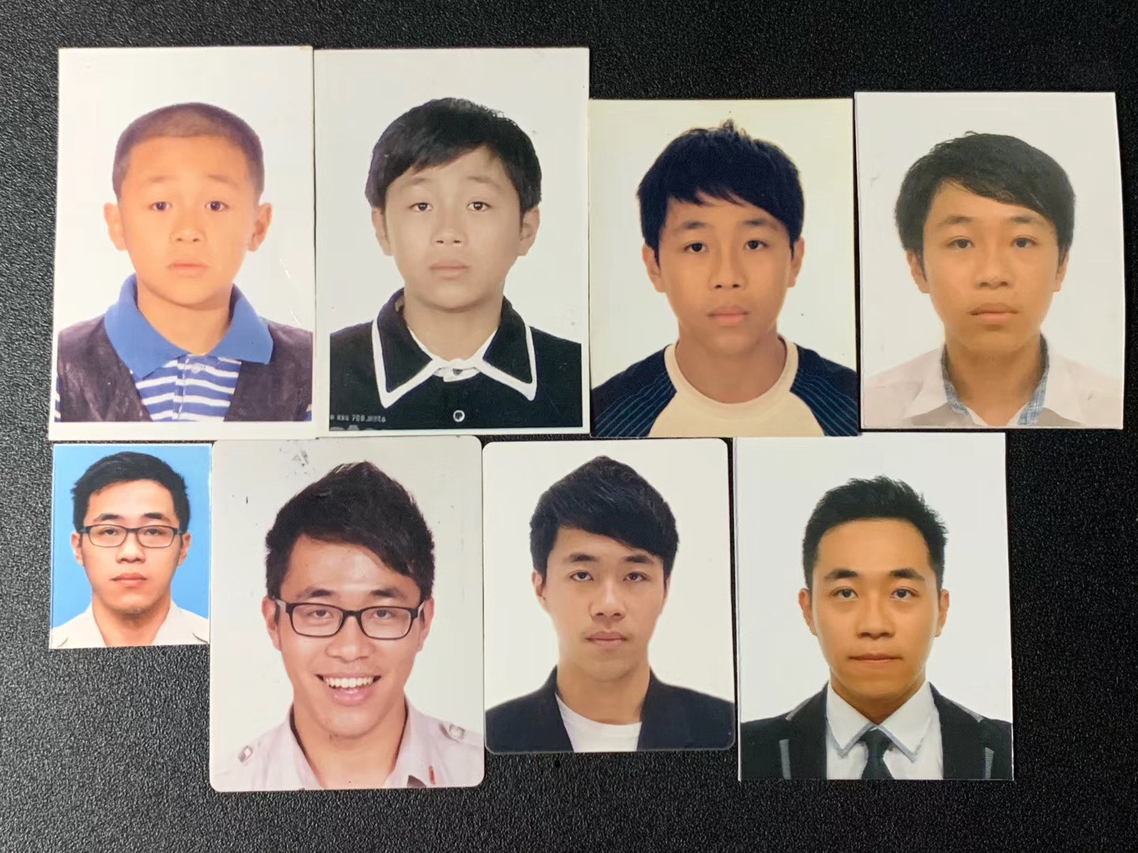
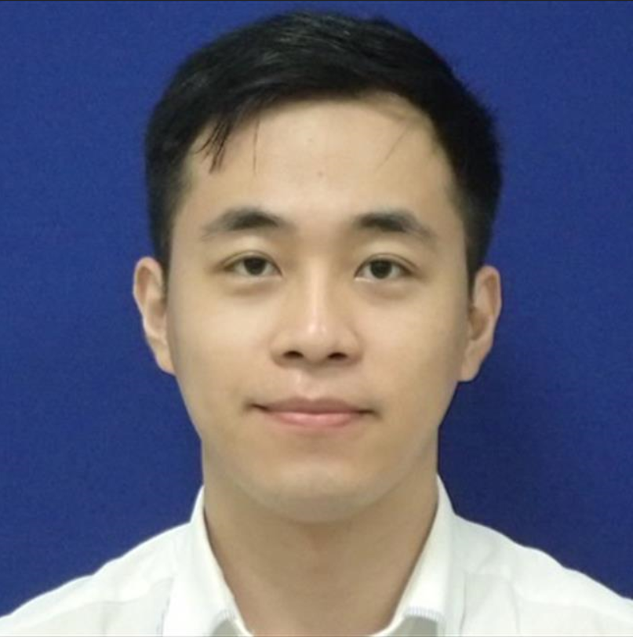
About Me
Born in China
Came to Singapore since Primary School
Studied in West Spring, NJC & NUS
CCA in Band, Orchestra, Boxing, Investment Club
Interned in NEA, PwC, Bloomberg, Micron
Interested in Data Science/ML

Slide 3
Projects in GPDNA
Airflow Set-up
Spares Weeks of Supply
Ariba Spend Analysis

Slide 4
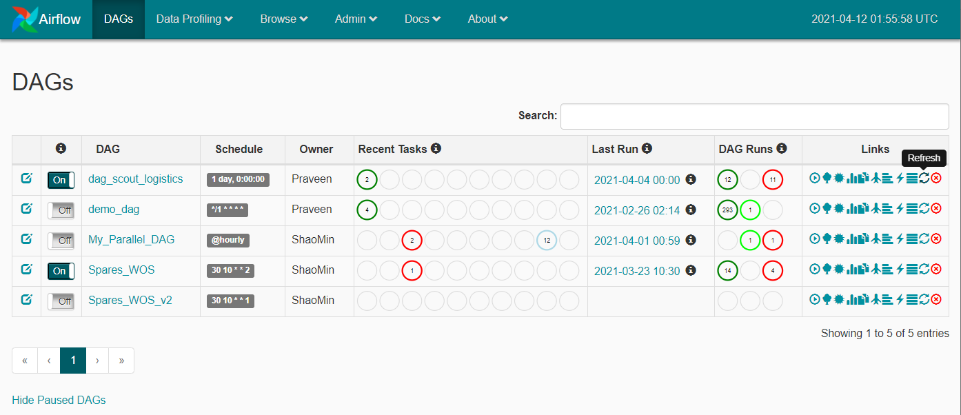
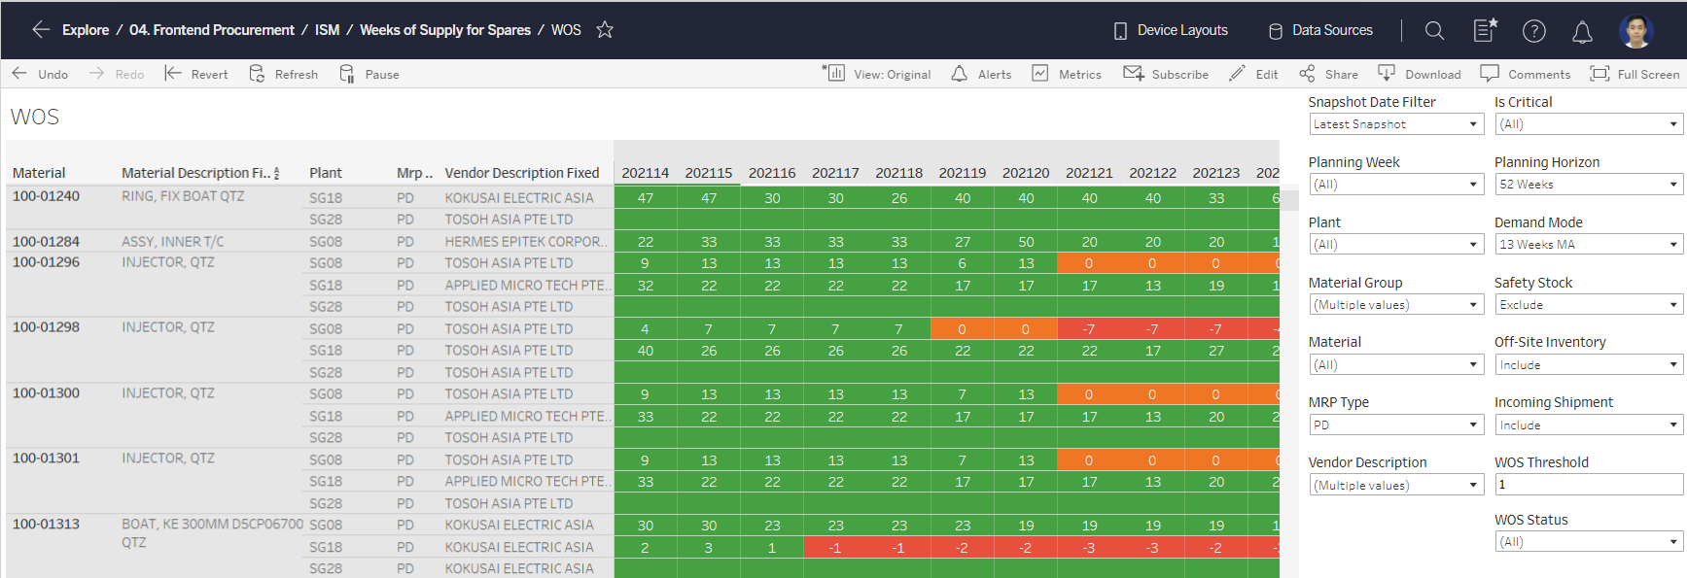
Requests
Airflow
Spares Weeks of Supply Report
Open-source automation tool
Scheduled Tasks
Reduce manual trigger
Reduce manhour
52 Weeks WOS forecast
Automated using Airflow

Slide 5
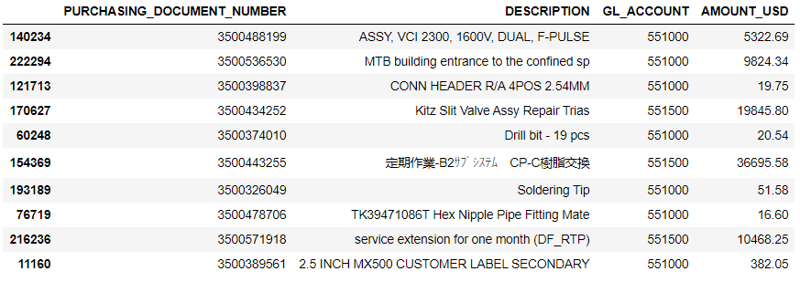
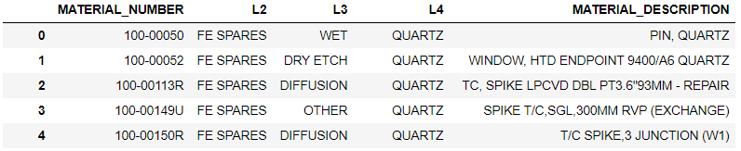
Ariba Spares Analysis
Material Description
From FY20 till now, Invoice spend through Ariba - $5 Billion
FE Spares (based on 4 GL’s) invoice spend through Ariba - $2 Billion (40%)
Materials with English Language Description – $1.6 Billion
Vendor Description may have some characteristic information present
Indicative information to L3

Slide 6
Ariba Spares Analysis
Cleaning
Normalisation
Keyword Extraction
Embedding
Classification
Symbols
Punctuations
Numerical values
Capitalization
Translation
Short Forms
Stop-Words
Tense/Form
Stemmatization
Lemmatization
Frequency
Percentage
Appearance Ratio
TF-IDF
Word-2-Vec
Frequency Count
KNN
Decision Tree
Random Forest
Naïve Baye

Slide 7
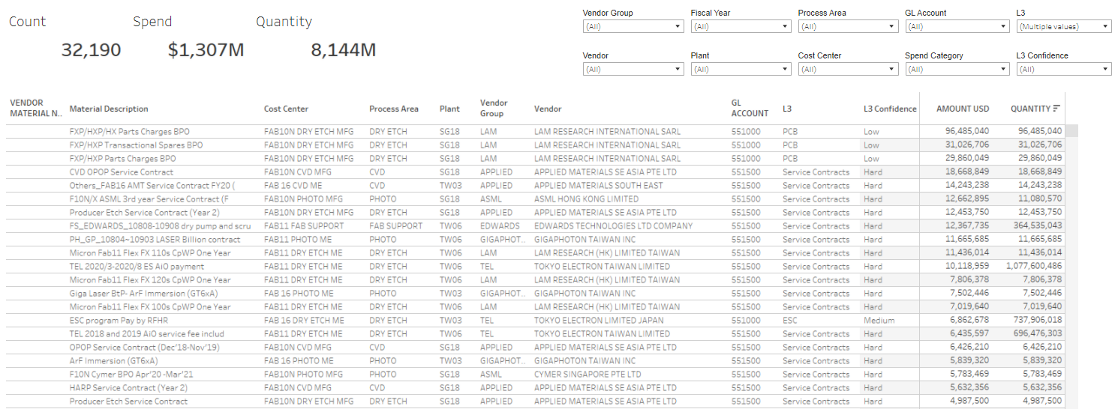
Ariba Spares Analysis

Slide 8
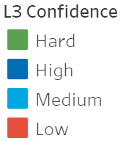
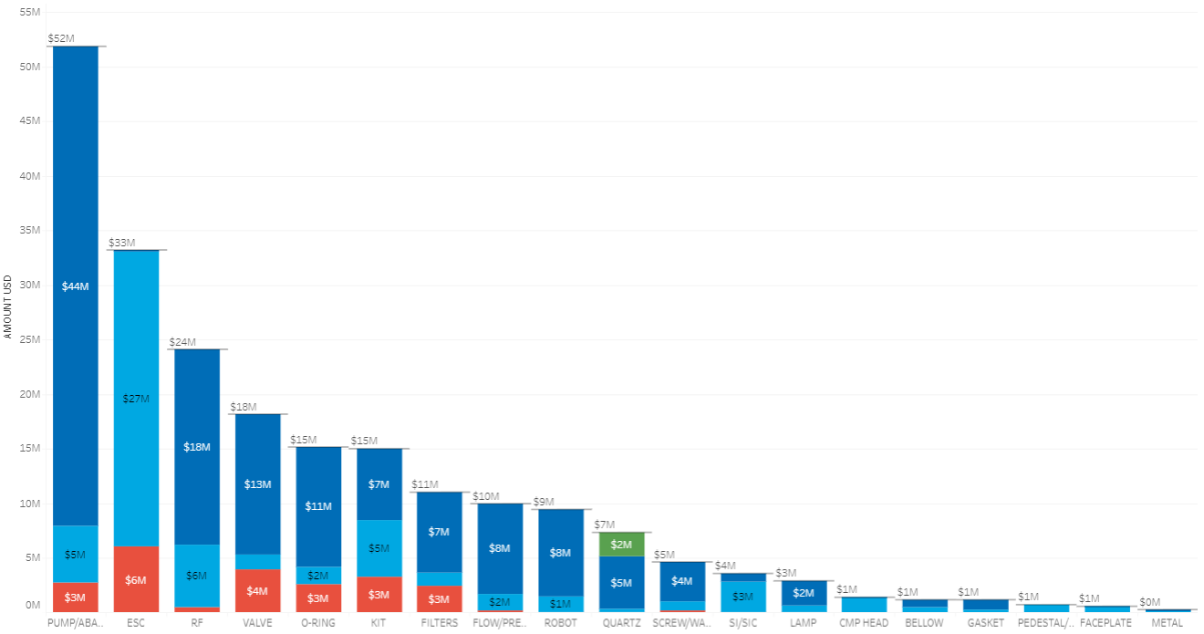
Ariba Spares Analysis
*High & Medium predictions are 80% accurate

Slide 13
Chart Example 1

Slide 15
Micron 3.1 Color Palette
Micron Logo
Primary
Charts & Graphs
Status only
l
= l (Wingdings)
p
= p (Wingdings 3)
u
= u (Wingdings)
Visit the Brand Portal (alias: brandportal/) to access additional logos, icons, and PowerPoint resources.

